Slide 1
WIND ENERGY

Slide 2
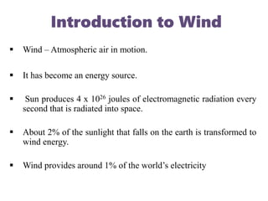

Slide 4
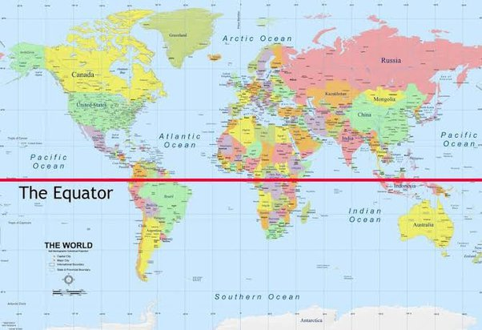

Slide 5
Wind is the movement of air caused by the uneven heating of the Earth by the sun.
Differences in atmospheric pressure generate winds.
At the Equator, the sun warms the water and land more than it does the rest of the globe. Warm equatorial air rises higher into the atmosphere and migrates toward the poles. This is a low-pressure system.
At the same time, cooler, denser air moves over Earth’s surface toward the Equator to replace the heated air. This is a high-pressure system.
Winds generally blow from high-pressure areas to low-pressure areas.
The boundary between these two areas is called a front. The complex relationships between fronts cause different types of wind and weather patterns.

Slide 6
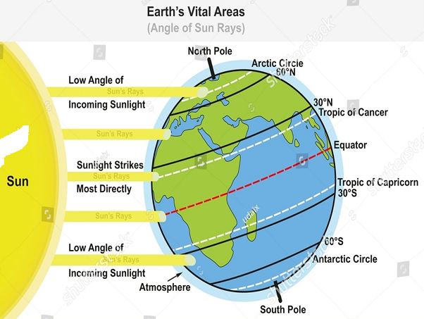

Slide 7
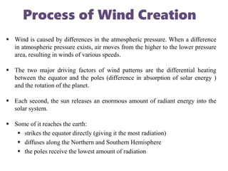

Slide 8
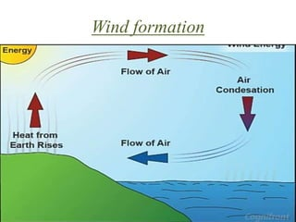

Slide 9
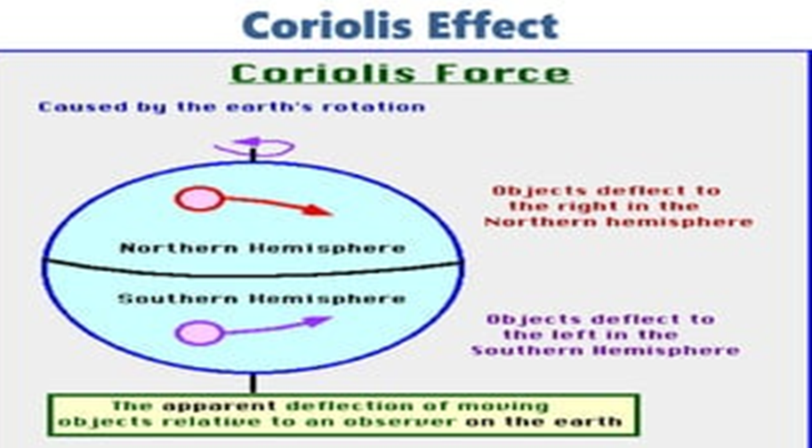

Slide 10
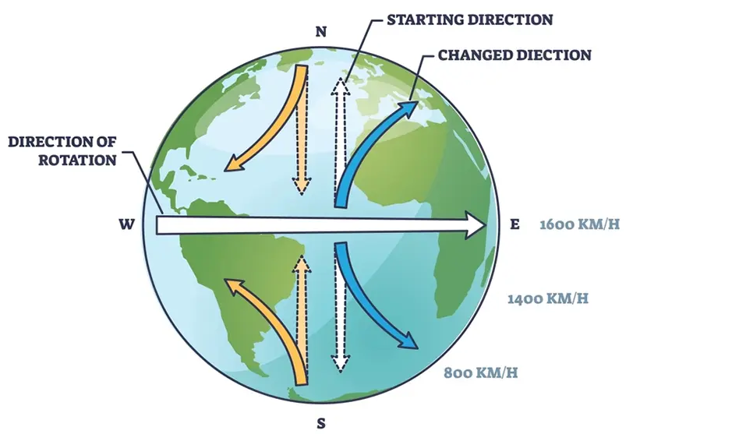

Slide 11
Unequal heating of the Earth’s surface also forms large global wind patterns.
In area near the equator, the sun is almost directly overhead for most of the year.
Warm air rises at the equator and moves toward the poles.
At the poles, the cooler air sinks and moves back toward the equator. However, it is not this simple.
Global winds do not move directly from north to south or south to north because the Earth rotates.
All winds in the Northern Hemisphere appear to curve to right as they move. In the southern hemisphere, winds appear to curve to the left. This is known as the Coriolis effect, which is the apparent shift in the path of any fluid or object moving about the surface of the Earth due to the rotation of the Earth.

Slide 12
The unequal heating of the surface of the planet, i.e., the temperature differences between the Equator and the Poles, combined with the Earth's rotation, is responsible for the creation and development of six major air circulation patterns, three in each hemisphere.
They are the Polar Easterlies, the Prevailing Westerlies, and the Trade Winds. Each one of them rules roughly 30 degrees of latitude, like wind belts around the Earth.
Because it receives the sun's most direct rays, the Equator has the globe's warmest temperatures.
On the opposite ends, the two Poles receive the most dispersed radiation, i.e., extremely low temperatures.
So, there's high pressure on the Poles (cold air) and low pressure on the Equator (warm air).
What happens is that hot air in the Equator rises and moves toward the Poles, while the cooler air at the Poles sinks and travels toward the Equator, creating a continuing wind system.

Slide 13
As Earth rotates from west to east and the Coriolis Effect kicks in, the winds on the Northern Hemisphere curve to the right, and the winds on the Southern Hemisphere curve to the left.
Generally, prevailing wind patterns around the world are westerly - going from west to east
The first air current moves from 90 degrees (the North Pole and the South Pole) and heats up quickly at 60 degrees (northern and southern hemispheres) - the air expands, rises, and cycles back in a counterclockwise loop. These are the so-called Polar Easterlies.
An identical process occurs between the Equator line (0 degrees) and 30 degrees (northern and southern hemispheres). These are the so-called Trade Winds.
But because the air gets trapped between 30 degrees and 60 degrees, a new convection current begins to take shape, this time in clockwise mode. These are the so-called Prevailing Westerlies.

Slide 14
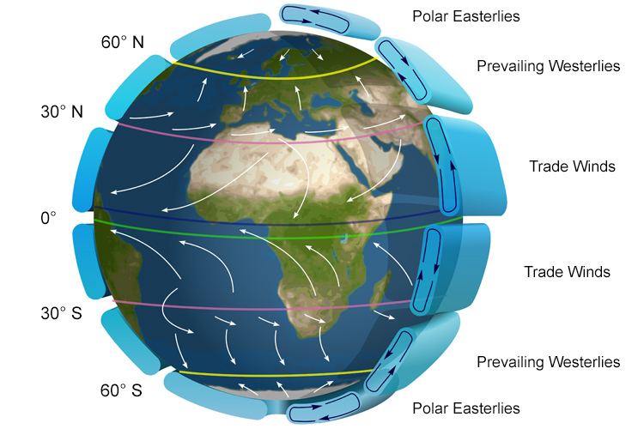

Slide 15
The Jet Stream
The wind doesn't go across the Equator very often. It's almost like a no-wind zone. Sailors call it the "doldrums."
But sailing problems also take place in the area between the Prevailing Westerlies and the Trade Winds zone, about 30 degrees north.
In the past, sailors would get weight out of caravels by dumping horses overboard to travel faster. That is why the 30th parallel north ended up being called the Horse Latitude.
The collision between the Polar Easterlies (high-pressure air) and the Prevailing Westerlies (lower pressure air) forms a fast, powerful wind that moves from the west to the east - the Jet Stream.
The Jet Stream moves in a swirl pattern and changes on a daily basis. It is responsible for the transportation of weather systems.

Slide 16
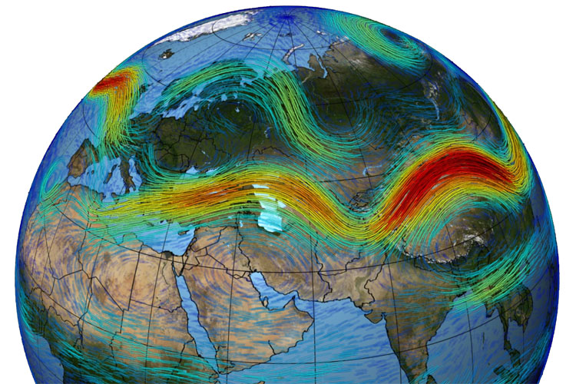

Slide 17
All six wind patterns travel north in the northern summer and south in the northern winter.
However, because there are higher temperature differences and more landmass in the northern hemisphere, the regions located north of the Equator observe more extreme wind currents and weather events than the southern hemisphere.
The anemometer is a scientific device for accurately measuring wind intensity.
Winds are the result of pressure differences. An accurate, scientific wind map features several atmospheric variables, including:
Isobars: circular lines which represent the pressure difference (gradients);
Wind barbs: small little "keys" which indicate wind direction and wind speed;
Low-pressure center: designated by the letter "L";
High-pressure center: designated by the letter "H";

Slide 18
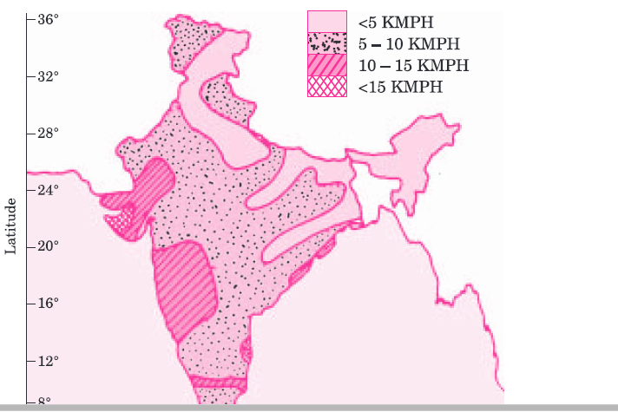
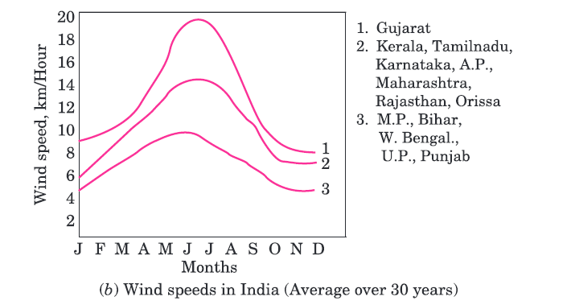

Slide 19
https://youtu.be/NQ3Tj-tdQIk
https://youtu.be/HDsUMqYuUm8

Slide 20
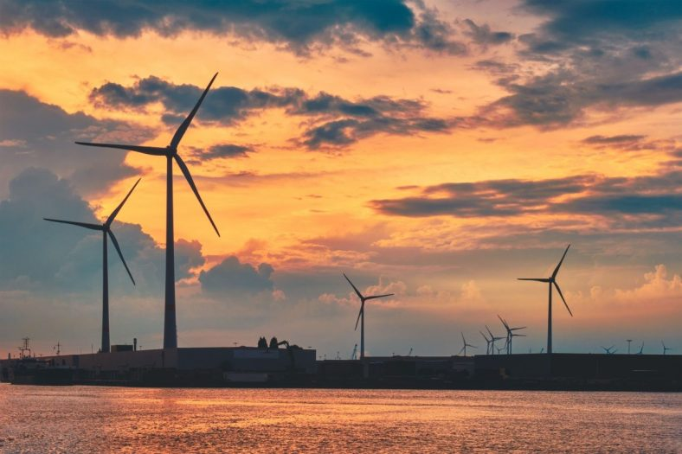
Basic Principle of Wind Energy Conversion
The utilization of wind to generate mechanical power or electricity is referred to as wind power or wind energy.
Wind turbines are devices that harness the kinetic energy of the wind and transform it into mechanical energy.
A generator can take this mechanical energy and turn it into electricity for general consumption or for a specific purpose, like grinding grain or pumping water.

Slide 21
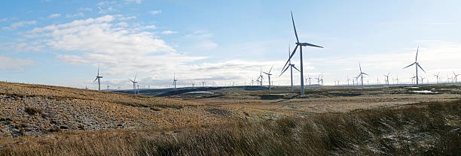
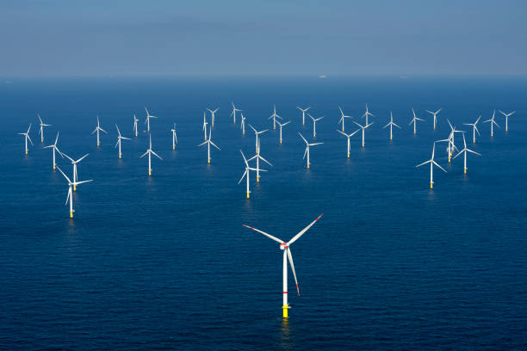
Depending on the location of the wind turbines, there are currently two distinct types of wind energy.
1. Onshore wind energy: By capturing the wind in land-based wind farms, onshore wind energy is responsible for generating electricity. As a means to this purpose, we set up wind turbines that can convert the kinetic energy of the wind into usable power that is then fed into the grid.
2. Offshore wind energy: This type of wind energy is obtained by using the force of the wind that is produced on the high seas.
Here the wind energy reaches a more constant and higher speed than on land. This happens because the high seas have the absence of barriers. Mega structures are installed in order to make the most out of this resource. These structures are seated on the seabed and are also equipped with the latest technological innovations.

Slide 22
A wind turbine turns wind energy into electricity using the aerodynamic force from the rotor blades, which work like an airplane wing or helicopter rotor blade.
When wind flows across the blade, the air pressure on one side of the blade decreases. The difference in air pressure across the two sides of the blade creates both lift and drag. The force of the lift is stronger than the drag and this causes the rotor to spin.
The rotor connects to the generator, either directly (if it’s a direct drive turbine) or through a shaft and a series of gears (a gearbox) that speed up the rotation and allow for a physically smaller generator.
This translation of aerodynamic force to the rotation of a generator creates electricity.

Slide 23
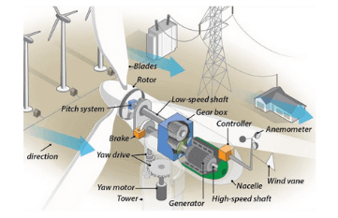

Slide 24
https://youtu.be/qSWm_nprfqE
https://youtu.be/Hf875eOVrVI
How Does Wind Turbine Work?
There is an air turbine of large blades attached on the top of a supporting tower of sufficient height.
When wind strikes on the turbine blades, the turbine rotates due to the design and alignment of rotor blades.
The shaft of the turbine is coupled with an electrical generator. The output of the generator is collected through electric power cables.

Slide 25
When the wind strikes the rotor blades, blades start rotating.
The turbine rotor is connected to a high-speed gearbox. Gearbox transforms the rotor rotation from low speed to high speed.
The high-speed shaft from the gearbox is coupled with the rotor of the generator and hence the electrical generator runs at a higher speed.
An exciter is needed to give the required excitation to the magnetic coil of the generator field system so that it can generate the required electricity. The generated voltage at output terminals of the alternator is proportional to both the speed and field flux of the alternator.
The speed is governed by wind power which is out of control. Hence to maintain uniformity of the output power from the alternator, excitation must be controlled according to the availability of natural wind power.
The exciter current is controlled by a turbine controller which senses the wind speed.
Then output voltage of electrical generator(alternator) is given to a rectifier where the alternator output gets rectified to DC. Then this rectified DC output is given to line converter unit to convert it into stabilized AC output which is ultimately fed to either electrical transmission network or transmission grid with the help of step up transformer.

Slide 26
There are other two control mechanisms attached to a modern big wind turbine.
Controlling the orientation of the turbine blade.
Controlling the orientation of the turbine face.
The orientation of turbine blades is governed from the base hub of the blades. The blades are attached to the central hub with the help of a rotating arrangement through gears and small electric motor or hydraulic rotary system. The system can be electrically or mechanically controlled depending on its design. The blades are swiveled depending upon the speed of the wind. The technique is called pitch control. It provides the best possible orientation of the turbine blades along the direction of the wind to obtain optimized wind power.

Slide 27
The orientation of the nacelle or the entire body of the turbine can follow the direction of changing wind direction to maximize mechanical energy harvesting from the wind. The direction of the wind along with its speed is sensed by an anemometer (automatic speed measuring devices) with wind vanes attached to the back top of the nacelle. The signal is fed back to an electronic microprocessor-based controlling system which governs the yaw motor which rotates the entire nacelle with gearing arrangement to face the air turbine along the direction of the wind.

Slide 28
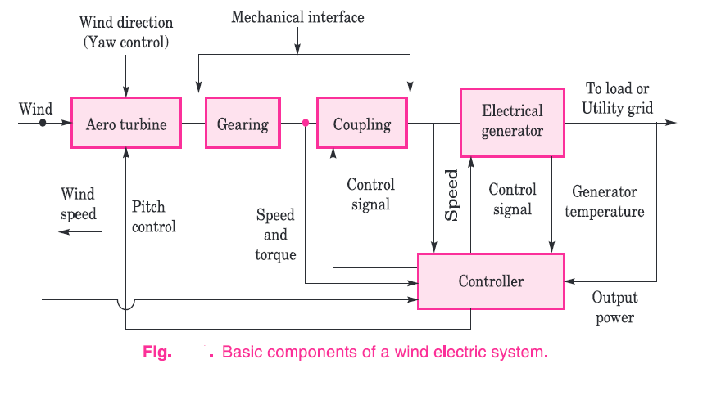

Slide 29
Basic Construction of Wind Turbine
Major Parts of Wind Turbine
1.Tower of Wind Turbine
Tower is very crucial part of wind turbine that supports all the other parts.
It not only supports the turbine but raises the turbine to sufficient height so that its blades tips would be at safe height during rotation. Not only that, there is need to maintain the height of the tower, so that it can get sufficiently strong wind.
The height of tower ultimately depends on the power capacity of wind turbines. The tower of the turbines in commercial wind power plants usually ranges from 40 meters to 100 meters.
These towers may be either tubular steel towers, lattice towers, or concrete towers. A tubular steel tower is used for a large wind turbine. These are normally manufactured in a section of 30 to 40 meters in length.
Each section has flanges with holes. Such sections are fitted together by nut bolts at the site to form a complete tower. The complete tower is slight conical shape to provide better mechanical stability.

Slide 30
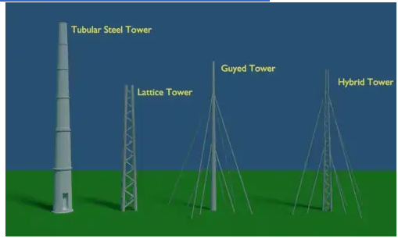
A lattice tower is assembled by different members of steel or GI angles or tubes. All members are bolted or welded together to form a complete tower of desired height. The cost of these towers are much less than that of steel tubular tower. Use of lattice tower is avoided in modern wind turbine plant due to its aesthetic look.
There is another type of tower used for small wind turbines, and this is guyed pole tower. Guyed pole tower is a single vertical pole supported by guy wired from different sides. Because of numbers of guy wires, it is difficult to access the footing area of the tower. Because of that, this type of tower is avoided in the agricultural field.
There is another type of wind turbine tower used for small plant, and this is a hybrid type tower. Hybrid type tower is also a guyed type tower, but the only difference is that instead of using a single pole in the middle it uses a thin and tall lattice type tower. Hybrid type tower is hybrid of both lattice type and guyed type tower.

Slide 31
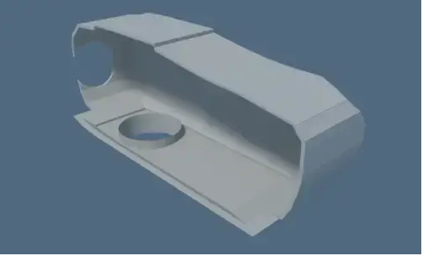
2. Nacelle of Wind Turbine
The nacelle is a big box or kiosk that sits on the tower and houses all the components of a wind turbine. It houses an electrical generator, power converter, gearbox, turbine controller, cables, a yaw drive.

Slide 32
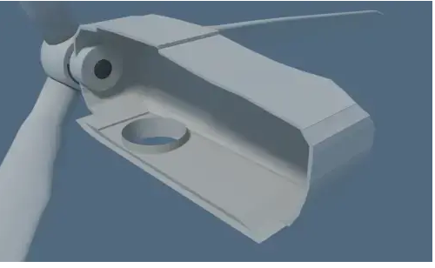
3.Rotor Blades of Wind Turbine
Blades are the main mechanical parts of a wind turbine. The blades convert wind energy into usable mechanical energy. The blades are designed like airplane wings. The wind turbine blades can be 40 meters to 90 meters long. The blades should be mechanically strong enough to withstand strong wind even during the storm. At the same time, the wind turbine blades should be made as light as possible to facilitate smooth rotation of the blades. For that, the blades are made with fiberglass and carbon fiber layers on synthetic reinforce.
In a modern turbine, normally three identical blades are fitted to a central hub using nut bolts. Each identical blades are aligned at 120º to each other. The process makes a better distribution of mass and gives the system more smooth rotation.

Slide 33
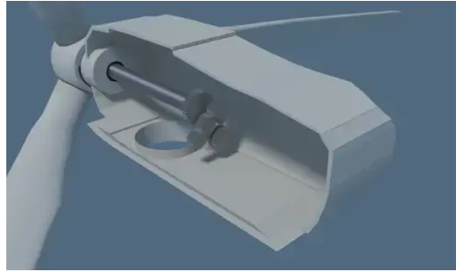
4. Shaft of Wind Turbine
The shaft directly connected to the hub is a low-speed shaft. When the blades rotate, this shaft spins with the same rpm as the rotating hub. We couple this shaft directly to the electrical generator in case of a low-speed generator. But in most cases, the low-speed main shaft is geared with a high-speed shaft through a gearbox. In this way, the rotor blades transfer its mechanical energy to the shaft which ultimately enters into an electrical generator.

Slide 34
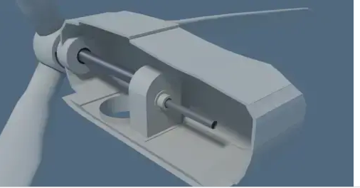
5. Gearbox
The wind turbine does not rotate at high speed rather it rotates gently at low speed. But most of the electrical generators require high-speed rotation, to generate electricity at a desired voltage level. So there must be some speed multiplication arrangement to achieve the high speed of the generator shaft. The gearbox of the wind turbine does this. Gearbox increases the speed to much higher value. For example, if the gearbox ratio is 1:80 and if the rpm of a low-speed main shaft is 15, the gearbox will increase the speed of generator shaft to 15 × 80 = 1200 rpm.

Slide 35
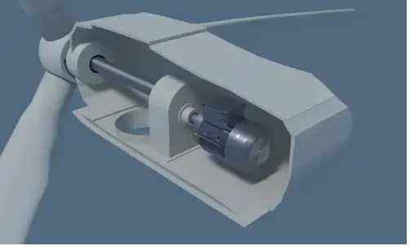
6. Generator
The generator is an electrical device that converts mechanical energy received from the shaft into electrical energy.
Normally, induction generators are used in modern wind turbines. Previously, synchronous generators were popular for this purpose. Permanent Magnet DC generator also used in some wind turbines.

Slide 36
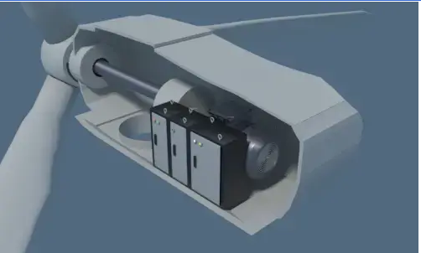
7. Power Converter
Because wind is not always constant, so electrical potential generated from a generator is not constant, but we need a very stable voltage to feed the grid. A power converter is an electrical device that stabilizes the alternating output voltage transferred to the grid.

Slide 37
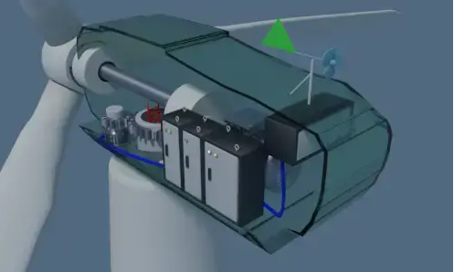
8.Turbine Controller
Turbine controller is a computer (PLC) that controls the entire turbine. It starts and stops the turbine and runs self diagnostic in case of any error in the turbine.
9.Anemometer
It measures the wind speed and passes the speed information to PLC to control the turbine power.
10.Wind Vane
It senses the direction of the wind and passes the direction to PLC then PLC faces the blades in such a way that it cuts the maximum wind.

Slide 38
11. Pitch Drive
Pitch drive motors control the angle of blades whenever the wind changes it rotates the angle of blades to cut the maximum wind, which is called pitching of blades.
12. Yaw Drive
Blades and other components in wind turbine are housed in a nacelle, whenever any change in wind direction is there, the nacelle has to face in the direction of the wind to extract the maximum energy from wind. For this purpose yaw drive, a motor is used to rotate the nacelle. It is controlled by PLC that uses the wind vane information to sense the wind direction.

Slide 39
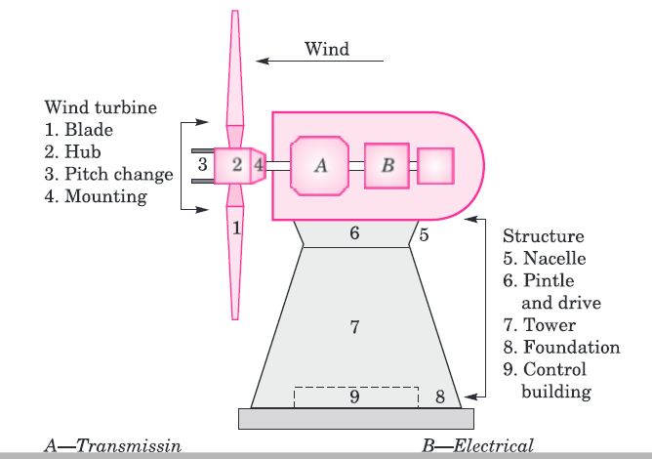

Slide 40
There are two main types of wind turbines based on the orientation of their axis: horizontal and vertical.
Horizontal Axis Wind Turbine
A horizontal axis wind turbine (HAWT) is defined as a wind turbine that has a horizontal or parallel axis of rotation with respect to the ground.
HAWTs are the most common type of wind turbines used for large-scale electricity generation.
They typically have three blades that resemble airplane propellers, although some may have two or one blades.

Slide 41
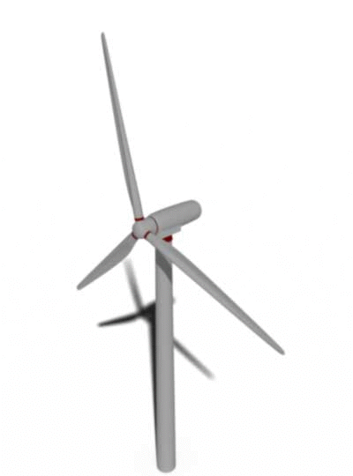
The main components of a HAWT are:
The rotor, which consists of the blades and the hub that connects them to the shaft.
The nacelle houses the generator, gearbox, brake, yaw system, and other mechanical and electrical components.
The tower supports the nacelle and the rotor and elevates them above the ground to capture more wind.
The foundation anchors the tower to the ground and transfers the loads from the wind turbine.

Slide 42
The working principle of a HAWT is based on a lift, which is the force that pushes an object upward when air flows over its surface. The blades of a HAWT are shaped like airfoils, which create a pressure difference between their upper and lower surfaces when the wind blows. This pressure difference causes the blades to rotate around the horizontal axis, which in turn drives the shaft and the generator to produce electricity.
The rotor plane of a HAWT must be aligned with the wind direction to maximize its efficiency. Therefore, a HAWT has a wind sensor and a yaw system that adjust the orientation of the nacelle according to the wind direction. A HAWT also has a pitch system that changes the angle of attack of the blades to control their rotational speed and power output.

Slide 43
The advantages of HAWTs are:
They have higher efficiency than vertical axis wind turbines (VAWTs) because they can capture more wind energy with less drag.
They have lower torque ripple and mechanical stress than VAWTs because they have fewer changes in aerodynamic forces during each rotation.
They can be installed offshore on floating platforms or fixed foundations, where the wind speed is higher and more consistent.
The disadvantages of HAWTs are:
They require a tall tower and a large land area to avoid turbulence and interference from nearby structures or terrain.
They are more expensive and complex to install and maintain than VAWTs because they have more moving parts and electrical components.
They are more susceptible to fatigue and damage from high winds, storms, lightning, birds, or ice.

Slide 44
Vertical Axis Wind Turbine
A vertical axis wind turbine (VAWT) is defined as a wind turbine that has a vertical or perpendicular axis of rotation with respect to the ground. VAWTs are less common than HAWTs, but they have some advantages for small-scale and urban applications. They usually have two or three blades that are either straight or curved.
The main components of a VAWT are:
The rotor, which consists of the blades and the vertical shaft that connects them to the generator.
The generator, which converts the mechanical energy of the rotor into electrical energy.
The base, which supports the rotor and the generator and connects them to the ground.

Slide 45
The disadvantages of VAWTs are:
They have lower efficiency than HAWTs because they have more drag and less lift.
They have higher torque ripple and mechanical stress than HAWTs because they have more changes in aerodynamic forces during each rotation.
They cannot be installed offshore because they are less stable and durable than HAWTs.

Slide 46
Comparison Between Horizontal and Vertical Axis Wind Turbines
The following table summarizes some of the main differences between horizontal and vertical-axis wind turbines:
Aspect | Horizontal Axis Wind Turbine | Vertical Axis Wind Turbine
Axis orientation | Parallel to the ground | Perpendicular to the ground
Wind direction | Must be aligned with it | Can capture it from any direction
Yaw system | Required | Not required
Pitch system | Required | Optional
Start-up mechanism | Not required | Required for some types
Efficiency | High | Low

Slide 47
Aspect | Horizontal Axis Wind Turbine | Vertical Axis Wind Turbine
Torque ripple | Low | High
Mechanical stress | Low | High
Installation cost | High | Low
Maintenance cost | High | Low
Noise level | High | Low
Height | High | Low
Land area | Large | Small
Offshore suitability | High | Low

Slide 48
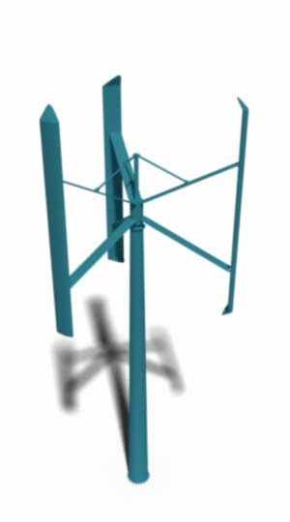
he working principle of a VAWT is based on drag, which is the force that opposes the motion of an object when air flows over its surface. The blades of a VAWT are symmetrical or asymmetrical, which create different amounts of drag when they face or oppose the wind direction. This drag difference causes the blades to rotate around the vertical axis, which in turn drives the generator to produce electricity.
The rotor plane of a VAWT does not need to be aligned with the wind direction because it can capture wind from any direction. Therefore, a VAWT does not have a yaw system or a wind sensor. However, a VAWT may have a pitch system that changes the angle of attack of the blades to control their rotational speed and power output.

Slide 49
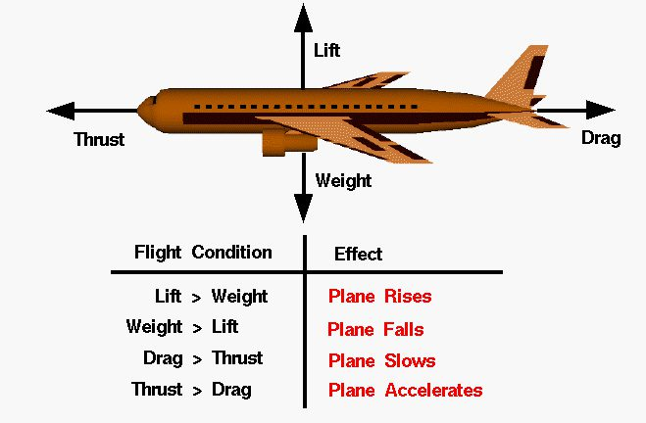
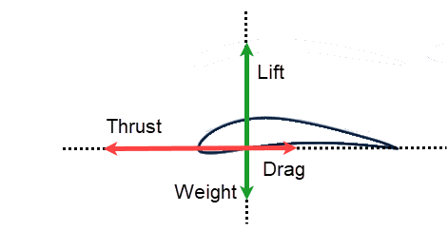
For an airplane in flight, the forces acting on it are its weight pulling it down and drag holding it back. Meanwhile, the airplane generates a thrust force to move forward and a lift force to counter its weight and keep flying. The airplane wing is made of several airfoils stacked along its axis.

Slide 50


SPEED AND POWER RELATIONS
If P = mechanical power in the moving air (watts),
ρ = air density (kg/m³),
A = area swept by the rotor blades (m²), and V = velocity of the air (m/sec),
then the volumetric flow rate is AV, the mass flow rate of the air in kilograms per second is ρAV,
and the mechanical power coming in the upstream wind is given by the following in watts:
This is the power in the upstream wind.
The blades cannot extract all of the upstream wind power, as some power is left in the downstream air that continues to move with reduced speed.

Slide 51
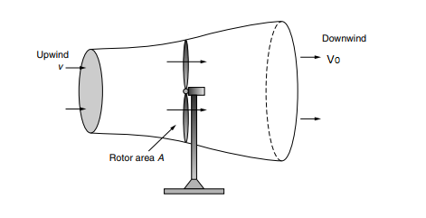

POWER EXTRACTED FROM THE WIND
The actual power extracted by the rotor blades is the difference between the upstream and downstream wind powers.
Figure : Approaching wind slows and expands as a portion of its kinetic energy is extracted by the wind turbine, forming the stream tube shown.
The power extracted by the blades is customarily expressed as a fraction of the upstream wind power in watts as follows:

Slide 52

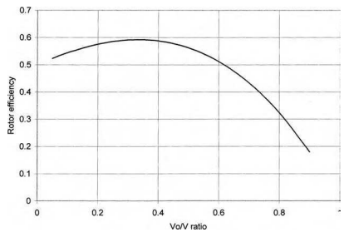
where
Cp is the fraction of the upstream wind power that is extracted by the rotor blades and fed to the electrical generator. The remaining power is dissipated in the downstream wind. The factor Cp is called the power coefficient of the rotor or the rotor efficiency
For a given upstream wind speed, Equation clearly shows that the value of Cp depends on the ratio of the downstream to the upstream wind speeds (Vo /V)
A plot of power vs. (Vo /V) shows that Cp is a single-maximum-value function (Figure). It has the maximum value of 0.59 when the Vo /V ratio is one third.
FIGURE : Rotor efficiency vs. Vo /V ratio has a single maximum

Slide 53

The maximum power is extracted from the wind at that speed ratio, i.e., when the downstream wind speed equals one third of the upstream speed. Under this condition (in watts):
This conclusion, that the maximum theoretical efficiency of a rotor is 59.3%, is called the Betz efficiency or, sometimes, Betz’ law

Slide 54
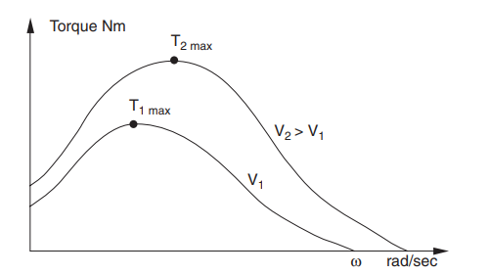
The typical turbine torque vs. rotor speed is plotted in Figure. It shows a small torque at zero speed, rising to a maximum value before falling to nearly zero when the rotor just floats with the wind. Two such curves are plotted for different wind speeds V1 and V2, with V2 being higher than V1.
FIGURE: Wind turbine torque vs. rotor speed characteristic at two wind speeds, V1 and V2.

Slide 55
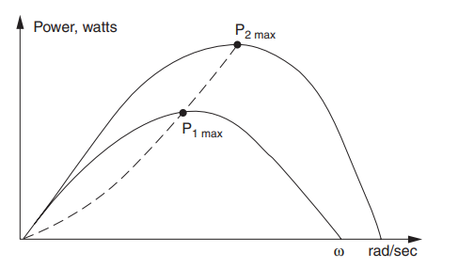
The corresponding power vs. rotor speed at the two wind speeds are plotted in Figure.
As the mechanical power converted into the electric power is given by the product of the torque T and the angular speed, the power is zero at zero speed and again at high speed with zero torque. The maximum power is generated at a rotor speed somewhere in between, as marked by P1max and P2max for speeds V1 and V2, respectively.
The speed at the maximum power is not the same speed at which the torque is maximum. The operating strategy of a well-designed wind power system is to match the rotor speed to generate power continuously close to the Pmax points. Because the Pmax point changes with the wind speed, the rotor speed must, therefore, be adjusted in accordance with the wind speed to force the rotor to work continuously at Pmax. This can be done with a variable-speed system design and operation. At a given site, the wind speed varies over a wide range from zero to high gust.
FIGURE : Wind turbine power vs. rotor speed characteristic at two wind speeds, V1 and V2

Slide 56

For a given wind speed, rotor efficiency is a function of the rate at which the rotor turns. If the rotor turns too slowly, the efficiency drops off since the blades are letting too much wind pass by unaffected. If the rotor turns too fast, efficiency is reduced as the turbulence caused by one blade increasingly affects the blade that follows. The usual way to illustrate rotor efficiency is to present it as a function of its tip-speed ratio (TSR). The tip-speed-ratio is the speed at which the outer tip of the blade is moving divided by the wind speed:
where rpm is the rotor speed, revolutions per minute; D is the rotor diameter (m); and v is the wind speed (m/s) upwind of the turbine.

Slide 57

The tip speed of the blade can be calculated as ω times R, where ω is the rotational speed of the rotor in radians/second, and R is the rotor radius in metres. Therefore, we can also write:
where 𝑣 is the wind speed in metres/second at the height of the blade hub.

Slide 58
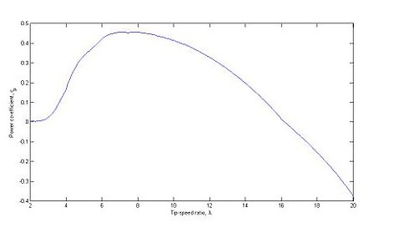
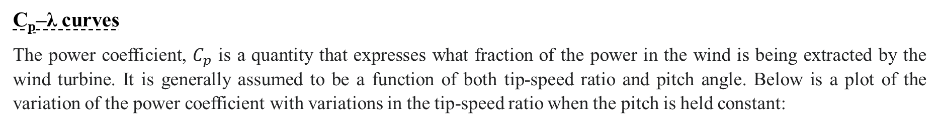
C_{p}–λ curves
The power coefficient, $C_{p}$ is a quantity that expresses what fraction of the power in the wind is being extracted by the wind turbine. It is generally assumed to be a function of both tip-speed ratio and pitch angle. Below is a plot of the variation of the power coefficient with variations in the tip-speed ratio when the pitch is held constant:

Slide 59
EX1:A 40-m, three bladed wind turbine produces 600 kW at a wind speed of 14 m/s. Air density is the standard 1.225 kg/m³. Under these conditions,
a. At what rpm does the rotor turn when it operates with a TSR of 4.0?
b. What is the tip speed of the rotor?
c. If the generator needs to turn at 1800 rpm, what gear ratio is needed to match the rotor speed to the generator speed?
d. What is the efficiency of the complete wind turbine (blades, gear box, generator) under these conditions?

Slide 60




b) The tip of each blade is moving at
c) If the generator needs to spin at 1800 rpm, then the gear box in the nacelle must increase the rotor shaft speed by a factor of
d) The power in the wind is

Slide 61

so the overall efficiency of the wind turbine, from wind to electricity, is

Slide 62
Determine the power in the wind if the wind speed is 20 m/s and blade length is 50 m.

Slide 63
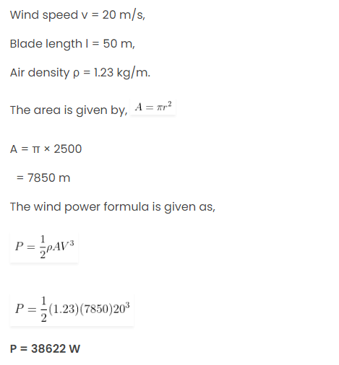

Slide 64
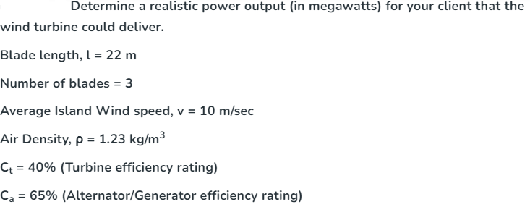

Slide 65
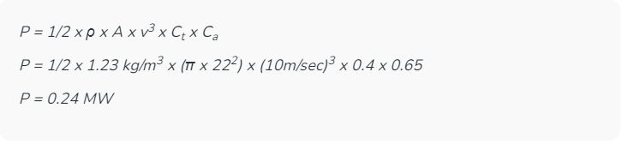

Slide 66
Calculate the Betz limit for a horizontal-axis wind turbine whose blades sweep a circular area with a diameter of 80 m, and for an upstream wind speed of v1 = 12 m/s.

Slide 67


Slide 68


Slide 69
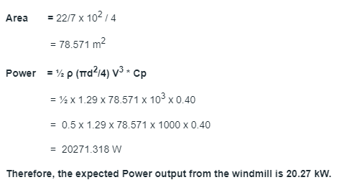

Slide 70


Slide 71
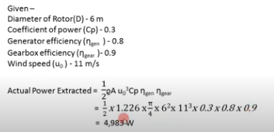

Slide 72
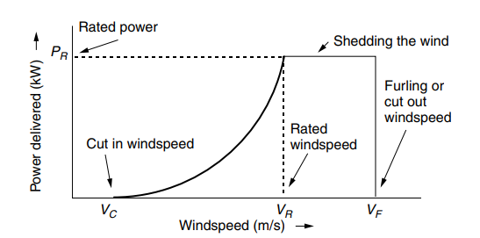
Idealized Wind Turbine Power Curve
The most important technical information for a specific wind turbine is the power curve, which shows the relationship between wind speed and generator electrical output. A somewhat idealized power curve is shown
So the type of wind turbine generator required for a particular location depends upon the energy contained in the wind and the characteristics of the electrical machine itself. All wind turbines have certain characteristics related to wind speed.
The generator (or alternator) will not produce output power until its rotational speed is above its cut-in wind speed where the force of the wind on the rotor blades is enough to overcome friction and the rotor blades accelerate enough for the generator to begin producing usable power.
Above this cut-in speed, the generator should generate power proportional to the wind speed cubed ( K.V³ ) until it reaches its maximum rated power output as shown.

Slide 73
Above this rated speed, the wind loads on the rotor blades will be approaching the maximum strength of the electrical machine, and the generator will be producing its maximum or rated power output as the rated wind speed window will have been reached.
If the wind speed continues to increase, the wind turbine generator would stop at its cut-out point to prevent mechanical and electrical damage, resulting in zero electrical generation. The application of a brake to stop the generator for damaging itself can be either a mechanical governor or electrical speed sensor.

Slide 74
Cut-in Wind speed: Low-speed winds may not have enough power to overcome friction in the drive train of the turbine and, even if it does and the generator is rotating, the electrical power generated may not be enough to offset the power required by the generator field windings. The cut-in wind speed VC is the minimum needed to generate net power. Since no power is generated at wind speeds below VC that portion of the wind’s energy is wasted. Fortunately, there isn’t much energy in those low-speed winds anyway, so usually not much is lost.
Rated Wind speed: As velocity increases above the cut-in wind speed, the power delivered by the generator tends to rise as the cube of wind speed. When winds reach the rated wind speed VR, the generator is delivering as much power as it is designed for.
Cut-out or Furling Wind speed: At some point the wind is so strong that there is real danger to the wind turbine. At this wind speed VF , called the cut-out wind speed or the furling wind speed (“furling” is the term used in sailing to describe the practice of folding up the sails when winds are too strong), the machine must be shut down. Above VF, output power obviously is zero.

Slide 75
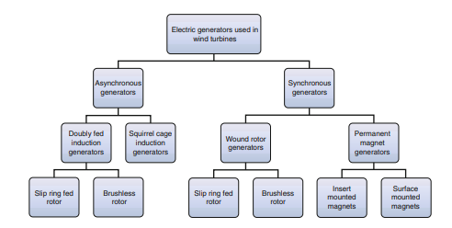
WIND TURBINE GENERATORS

Slide 76
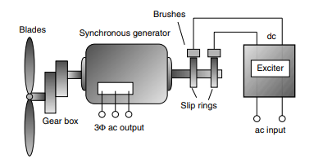
Synchronous Generators

Slide 77
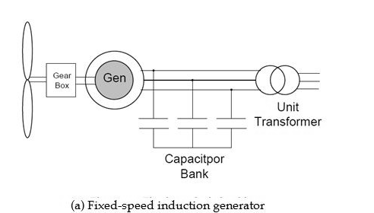
INDUCTION GENERATOR

Slide 78
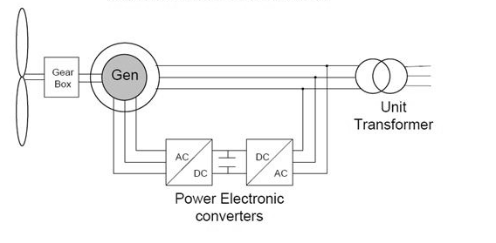
Fig(b) : Doubly –fed Induction generators

Slide 79
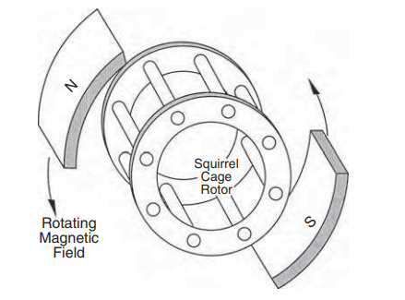
Squirrel cage rotor
The stator is made of numerous coils wound in three groups (phases), and is supplied with three-phase current. The three coils are physically spread around the stator periphery and carry currents, which are out of time phase. The angular speed of the rotating magnetic field is called the synchronous speed.
The stator coils are embedded in slots in a high-permeability magnetic core to produce the required magnetic field intensity with a small exciting current.
The rotor, however, has a completely different structure. It is made of solid conducting bars, also embedded in slots in a magnetic core.
The bars are connected together at both ends by two conducting end rings (Figure). Because of its resemblance, the rotor is called a squirrel cage rotor, or the cage rotor, for short, and the motor is called the squirrel cage induction motor.
FIGURE ;Squirrel cage rotor of the induction machine under rotating magnetic field.

Slide 80


The stator magnetic field is rotating at the synchronous speed. This field is conceptually represented by the rotating magnets in Figure.
The relative speed between the rotating field and the rotor induces the voltage in each closed loop of the rotor conductors linking the stator flux φ.
where φ = the magnetic flux of the stator linking the rotor loop.
This voltage in turn sets up the circulating current in the rotor. The electromagnetic interaction of the rotor current and stator flux produces the torque. The magnitude of this torque is given by the following:
where k = constant of proportionality
Φ = magnitude of the stator flux wave
I2= magnitude of induced current in the rotor loops
φ2 = phase angle by which the rotor current lags the rotor voltage

Slide 81
The rotor accelerates under this torque. If the rotor were on frictionless bearings in a vacuum with no mechanical load attached, it would be completely free to rotate with zero resistance.
Under this condition, the rotor would attain the same speed as the stator field, namely, the synchronous speed. At this speed, the current induced in the rotor is zero, no torque is produced, and none is required.
Under these conditions, the rotor finds equilibrium and will continue to run at the synchronous speed.
If the rotor is now attached to a mechanical load such as a fan, it will slow down. The stator flux, which always rotates at a constant synchronous speed, will have a relative speed with respect to the rotor.
As a result, electromagnetically induced voltage, current, and torque are produced in the rotor. The torque produced must equal that needed to drive the load at this speed. The machine works as a motor in this condition.

Slide 82
If we attach the rotor to a wind turbine and drive it faster than its synchronous speed via a step-up gear, the induced current and the torque in the rotor reverse the direction. The machine now works as the generator, converting the mechanical power of the turbine into electric power, which is delivered to the load connected to the stator terminals.
If the machine were connected to a grid, it would feed power into the grid. Thus, the induction machine can work as an electrical generator only at speeds higher than the synchronous speed.
The generator operation, for this reason, is often called the supersynchronous operation of the induction machine
An induction machine needs no electrical connection between the stator and the rotor. Its operation is entirely based on electromagnetic induction; hence, the name.
The absence of rubbing electrical contacts and simplicity of its construction make the induction generator a very robust, reliable, and low-cost machine. For this reason, it is widely used in numerous industrial applications

Slide 83
The slip is positive in the motoring mode and negative in the generating mode.
In both modes, a higher rotor slip induces a proportionally higher current in the rotor, which results in greater electromechanical power conversion.
In both modes, the value of slip is generally a few to several percent. Higher slips, however, result in greater electrical loss, which must be effectively dissipated from the rotor to keep the operating temperature within the allowable limit.
The induction generator feeding a 60-Hz grid must run at a speed higher than 3600 rpm in a 2-pole design, 1800 rpm in a 4-pole design, and 1200 rpm in a 6- pole design.
The wind turbine speed, on the other hand, varies from a few hundred rpm in kW-range machines to a few tens of rpm in MW-range machines.
The wind turbine, therefore, must interface the generator via a mechanical gear. As this somewhat degrades efficiency and reliability, many small stand-alone plants operate with custom-designed generators operating at lower speeds without any mechanical gear.

Slide 84
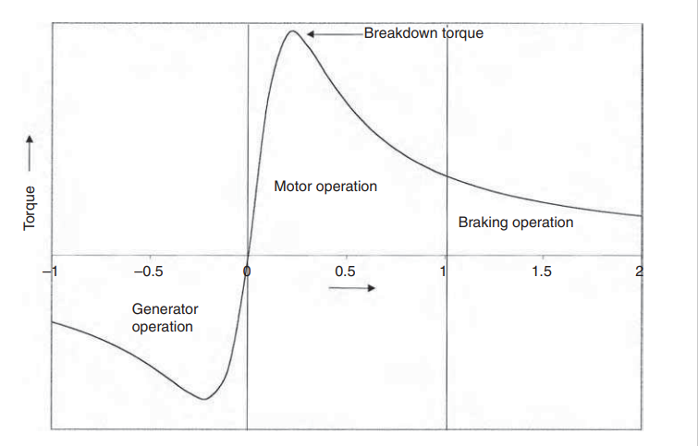
FIGURE : Torque vs. speed characteristic of the induction machine in three operating modes.

Slide 85
DOUBLY FED INDUCTION GENERATOR
There are two three-phase windings, one stationary and one rotating, both separately connected to equipment outside the generator. Thus, the term doubly fed is used for this kind of machines.
One winding is directly connected to the output, and produces 3-phase AC power at the desired grid frequency. The other winding (traditionally called the field, but here both windings can be outputs) is connected to 3-phase AC power at variable frequency. This input power is adjusted in frequency and phase to compensate for changes in speed of the turbine.
Adjusting the frequency and phase requires an AC to DC to AC converter. This is usually constructed from very large IGBT semiconductors. The converter is bidirectional, and can pass power in either direction. Power can flow from this winding as well as from the output winding
The primary advantage of doubly-fed induction generators when used in wind turbines is that they allow the amplitude and frequency of their output voltages to be maintained at a constant value, no matter the speed of the wind blowing on the wind turbine rotor.
Because of this, doubly-fed induction generators can be directly connected to the ac power network and remain synchronized at all times with the ac power network. Other advantages include the ability to control the power factor, while keeping the power electronics devices in the wind turbine at a moderate size.

Slide 86
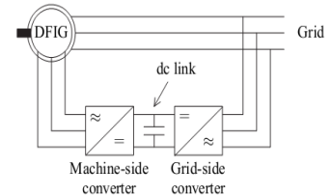
The back-to-back converter consists of two converters, i.e., machine-side converter and grid-side converter that are connected back-to back.
Between the two converters a dc-link capacitor is placed, as energy storage, in order to keep the voltage variations (or ripple) in the dc-link.
With the machine-side converter it is possible to control the torque or the speed of the DFIG and also the power factor at the stator terminals, while the main objective for the grid-side converter is to keep the dc-link voltage constant.
Fig.. DFIG system with a back-to-back converter

Slide 87
MPPT for WECS
MPPT controllers are used for extracting maximum power from the WECS using different generators such as permanent magnet synchronous generators (PMSG), squirrel cage induction generators (SCIG) and doubly fed induction generator (DFIG).
The MPPT controllers can be classified into three main control methods, namely tip speed ratio (TSR) control, power signal feedback (PSF) control and hill-climb search (HCS) control.The energy produced from wind source depends upon the accuracy with which the peak power points are tracked by the MPPT controller of the WECS control system irrespective of the type of generator used.

Slide 88
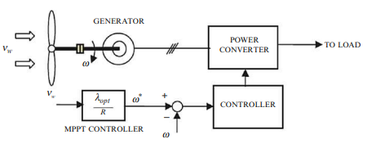
In the TSR control method, the rotational speed of the generator is regulated in order to maintain the tip speed ratio to an optimum value during which the power extracted attains the maximum.
In this method in order to obtain the maximum output power, the speed from both wind and the turbine are required along with the optimal value of the TSR of the turbine.
The block diagram of a WECS with TSR control is shown in Fig.
Fig.: Tip speed ratio control of WECS

Slide 89
This method is simple, however, it requires the measurement of wind speed consistently and accurately which complicates its use in the reality, as well as increases the system cost.

Slide 90
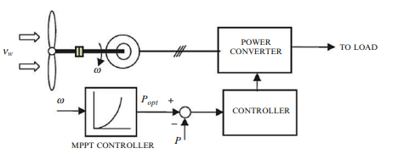
In PSF control, it is required to have the knowledge of the wind turbine’s maximum power curve, and track this curve through its control mechanisms.
The maximum power curves need to be obtained via simulations or off-line experiment on individual wind turbines.
In this method, reference power is generated either using a recorded maximum power curve or using the mechanical power equation of the wind turbine where wind speed or the rotor speed is used as the input.
Figure, shows the block diagram of a WECS with PSF controller for maximum power extraction.
Fig: Power signal feedback control

Slide 91

HCS control algorithm
Fig. : HCS control principle

Slide 92

Fig. : WECS with hill climb search control

Slide 93
wind farm
A wind farm or wind park, also called a wind power station or wind power plant, is a group of wind turbines in the same location used to produce electricity.
Wind farms vary in size from a small number of turbines to several hundred wind turbines covering an extensive area. Wind farms can be either onshore or offshore.
Many of the largest operational onshore wind farms are located in China, India, and the United States.
Because they require no fuel, wind farms have less impact on the environment than many other forms of power generation and are often referred to as a good source of green energy.

Slide 94
How many turbines can be installed at a given site?
wind turbines located too close together will result in upwind turbines interfering with the wind received by those located downwind.
As the wind is slowed as some of its energy is extracted by a rotor, which reduces the power available to downwind machines. Eventually, however, some distance downwind, the wind speed recovers.
Theoretical studies of square arrays with uniform, equal spacing illustrate the degradation of performance when wind turbines are too close together.
Figure shows array efficiency (predicted output divided by the power that would result if there were no interference) as a function of tower spacing expressed in rotor diameters. The parameter is the number of turbines in an equally-spaced array. That is, for example, a 2 × 2 array consists of four wind turbines equally spaced within a square area, while an 8 × 8 array is 64 turbines in a square area. The larger the array, the greater the interference, so array efficiency drops.

Slide 95

Figure: Impact of tower spacing and array size on performance of wind turbines

Slide 96

Experience has yielded some rough rules of-thumb for tower spacing of such rectangular arrays. Recommended spacing is 3–5 rotor diameters separating towers within a row and 5–9 diameters between rows.
The offsetting, or staggering, of one row of towers behind another, as illustrated in Fig. is also common.
Figure: Optimum spacing of towers is estimated to be 3–5 rotor diameters between wind turbines within a row and 5–9 diameters between rows

Slide 97
GRID INTEGRATION
The association of the windmill to the grid depends on the electrical generator as well as power electronic converters used.
Based about the application of PE converters in the WECS, the turbine configurations can be divided into a few topologies: directly connected to the grid without any PE converter, connected via full-scale the PE converter, and connected via partially-rated PE converter.

Slide 98

As a basic, robust and reasonably low-cost program, a squirrel-cage induction generator (SCIG), as an asynchronous machine, will be connected directly towards the grid, as represented in Fig. For a good induction generator, using a gearbox is required in order to interface the turbine speed and generator speed.
Fig: Wind turbine system with SCIG

Slide 99
However, the configuration based with almost fixed pace is not suitable for a windmill in an increased power range as well as for locations together with widely varying the wind velocity.
Three wind turbine systems based on induction generators, while using the capability of variable-speed operation are shown in following Fig.. The wind turbine system in Fig. (a) uses a wound-rotor induction turbine (WRIG). The concept of this model is the rotor resistance might be varied electronically having a variable external rotor resistance and a PE converter. Simply by controlling the rotor coil resistance, the output of the unit will be improved over a 10 % range (speed range 2–4 %).
Figure (b) shows a setting employing a Doubly-Fed Induction Source (DFIG) and power electronic converters that connects this rotor winding towards grid directly. On this configuration, it is quite possible to extend the speed range further without affecting the efficiency. The reason behind speed control without having loss of productivity is that fall power can follow back to the grid by the particular converter instead to be wasted in the rotor resistance.
In order to solve the difficulties of using get rings and brushes one alternative is utilizing the Brushless Doubly-Fed induction generator (BDFIG), shown in Fig. (c). In this scheme, the stator coil windings (main winding) are directly connected to the grid, while three-phase auxiliary winding is connected on the electrical grid by having a PE converter. When using the appropriate control within the auxiliary winding, the user possibly can control the trigger machine at any speed virtually.

Slide 100

Fig.: Wind turbine systems based on induction generator with capability of variable-speed operation: (a) Wound-Rotor, (b) Doubly-Fed, and (c) Brushless Doubly-Fed induction generators

Slide 101
With restructuring and technological changes in the utility sector, electric utilities have begun to include wind farms and PV parks in their resource mix. The issues the power industry must deal with in integration of these new power sources are the following:
• Branch power flows and node voltages
• Protection scheme and its ratings
• Harmonic distortion and flicker
• Power system dynamics and dynamic stability
• Reactive power control and voltage control
• Frequency control and load dispatch from conventional generators

Slide 102
Wind energy (and other forms of variable renewable energy like solar photovoltaic cells) has the following unique characteristics, and consequently, implications when connected to the grid:
Wind energy is variable and uncertain. The first implication is that other generators on the grid must react not only to load variability, but also to wind energy variability. This requires conventional generators to support higher ramp rates in both directions. The second implication is that for cost-efficient operations, accurate wind energy forecasts and responsive systems operations are necessary.
Wind generator is asynchronous in contrast to synchronous conventional generators. The implication is that wind energy provides no inertial response, so when wind energy penetration is high, grid inertia can be low. As a consequence, the grid may become unstable—unable to provide a stable sub second-to-second frequency response in reaction to fault on the grid.
Wind energy is on priority dispatch. The first implication is that it displaces conventional generation, leading to lower minimum operating levels, and longer and more frequent shutdowns of conventional generators. The second implication is that wind energy may be curtailed during periods of off-peak load, high wind production, and generators operating at minimum capacity

Slide 103
(iv) Wind energy is usually not proximate to load centers. The implications are new transmission or upgrade to existing transmission may be required; losses may be high; and voltage level may fluctuate beyond acceptable levels at interconnection point, thereby necessitating reactive power compensation.

